Slide 1
YOUTUBE SONG ANALYSIS
BY – Ashish Nishad
Batch Name: MIP-DA-10
Profile: Data Analyst Intern

Slide 2
Project overview and objective: - This project aims to analyze YouTube song data using Power BI comprehensively. - The dataset contains key attributes such as video ID, channel title, title, description, tags, published date, view count, like count, favorite count, comment count, video duration, video definition, and caption details. - The goal is to utilize Power BI to create insightful visualizations and reports that provide a deeper understanding of YouTube songs' performance, popularity, and user engagement. - The analysis aims to cover trends, preferences, and patterns in the data to aid content creators and stakeholders in optimizing their YouTube song content.

Slide 3
Data collection and data cleaning
Data imported to Power BI desktop.
Data cleaning:
Managing and eliminating null values from the Data set.
Removing redundant columns.
Formatting columns order-wise.
Creating new columns

Slide 4
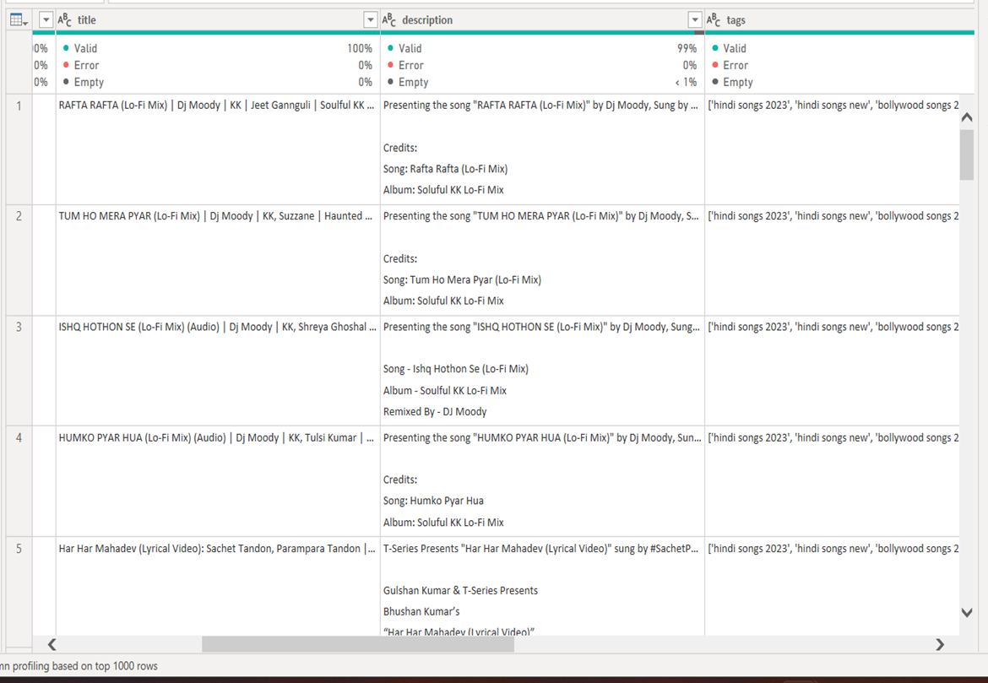
Getting null values
Getting null values

Slide 5
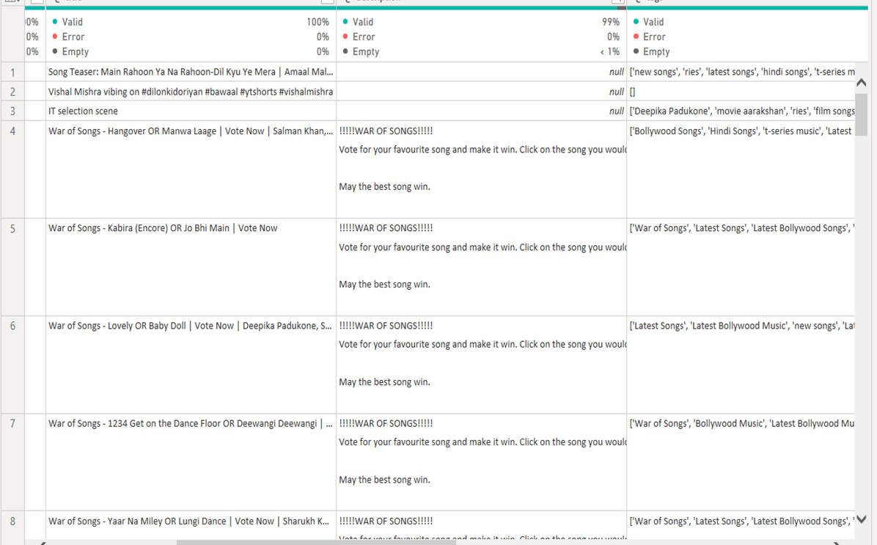
Sorting and detecting null values

Slide 6
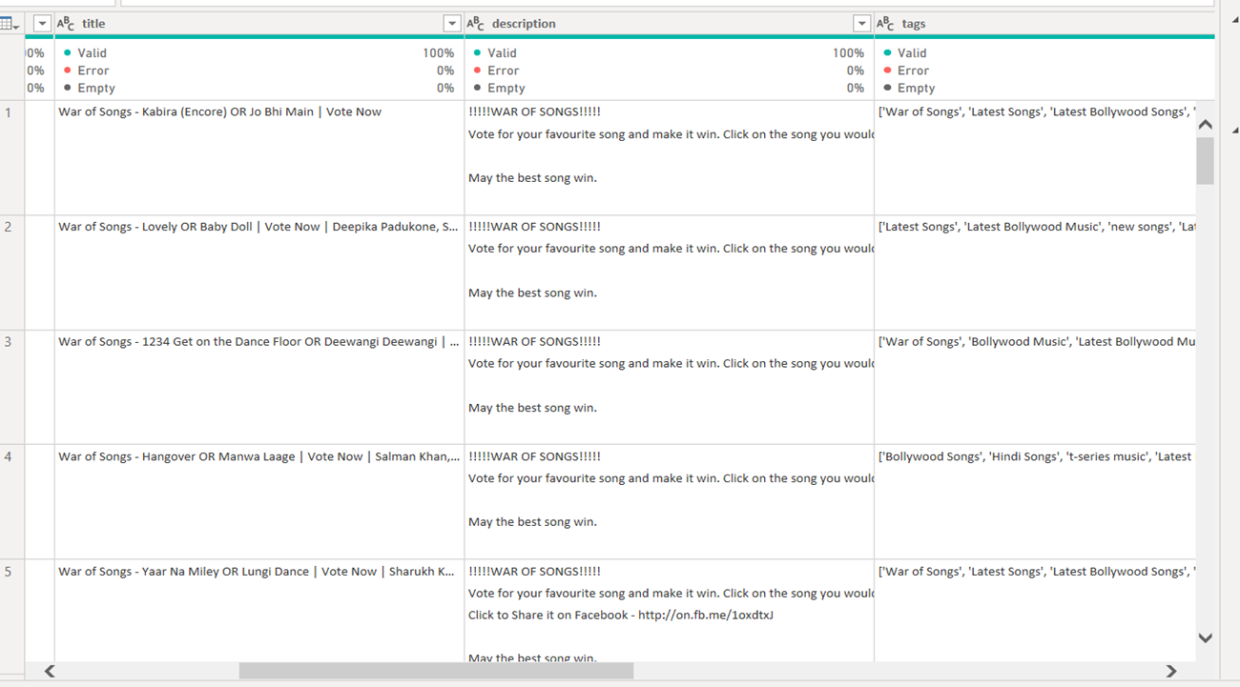
Removing null values

Slide 7
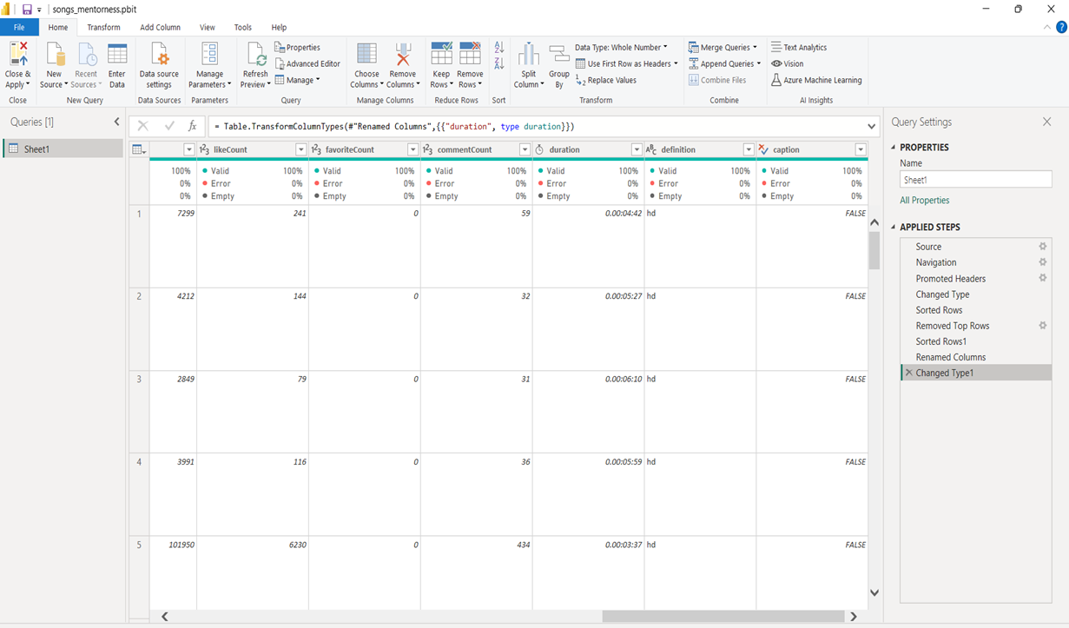
Changing and checking the data type of each column

Slide 8
1) Important KPI’s: using cards

Slide 9
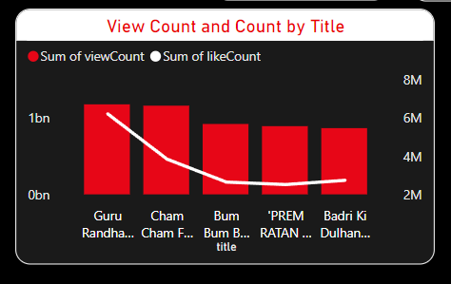
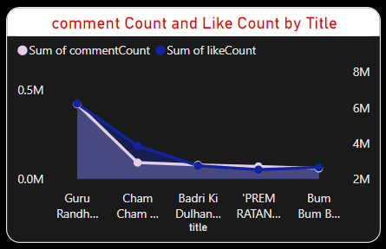
2) Exploratory Data Analysis (EDA): - explore patterns and distributions in view counts, like counts, and comments. - identify trends in the popularity and engagement of YouTube song videos.

Slide 10
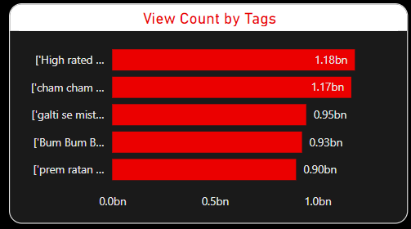
3) Content and Channel Analysis: - Analyze the distribution of videos across different channels. - Identify popular tags and their correlation with view counts.

Slide 11
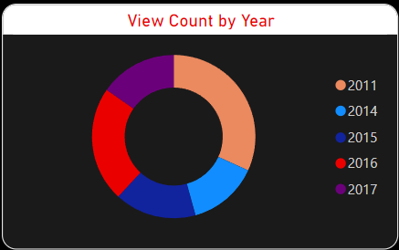
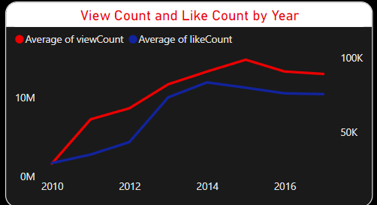
4) TEMPORAL TRENDS: - Explore how YouTube song video metrics vary over time. - Identify peak publishing times and their impact on engagement.

Slide 12
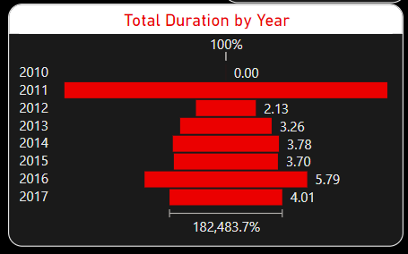
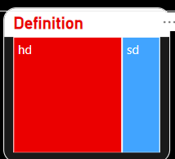

5) User Engagement Insights: - investigate relationships between likes, comments, and views. - identify factors influencing user engagement with YouTube song videos.
.
.
.
.
.
.

Slide 13
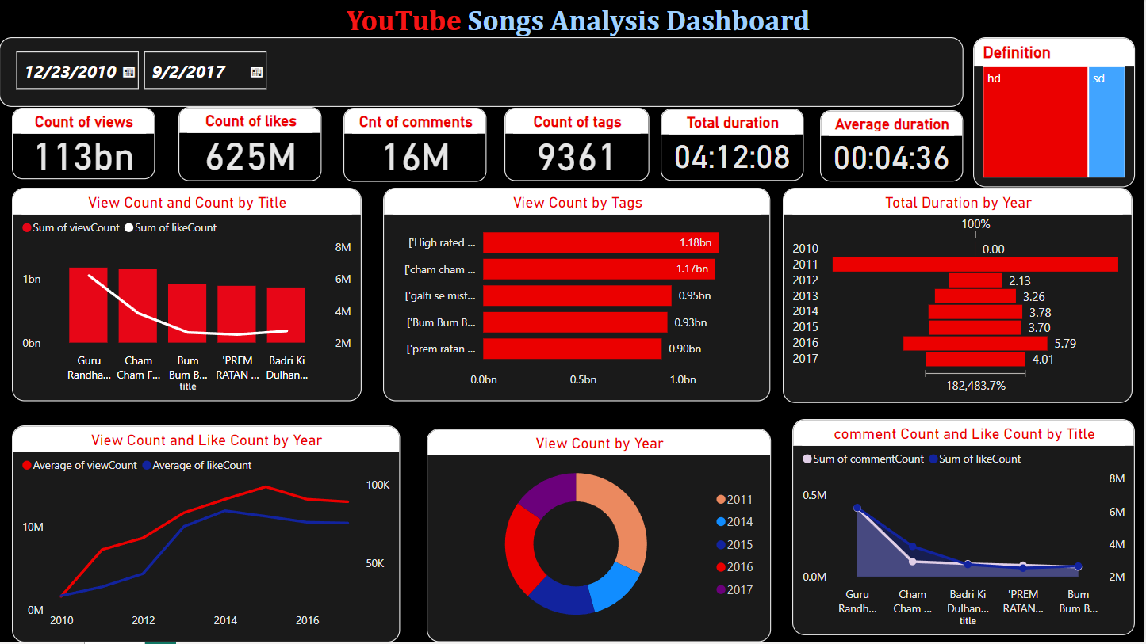
Final dashboard

Slide 14
Conclusion:
The Definition of video greatly affects engagement in watching videos. Now HD is more preferred as compared to SD.
Tags play an important role as far as performance is concerned. Therefore tags should be such that they easily relate to the viewer and can be found out easily when searched.
Duration of video is another factor that affects enormously on the performance of a video. Therefore, this should also be kept in mind.

